Slide 1

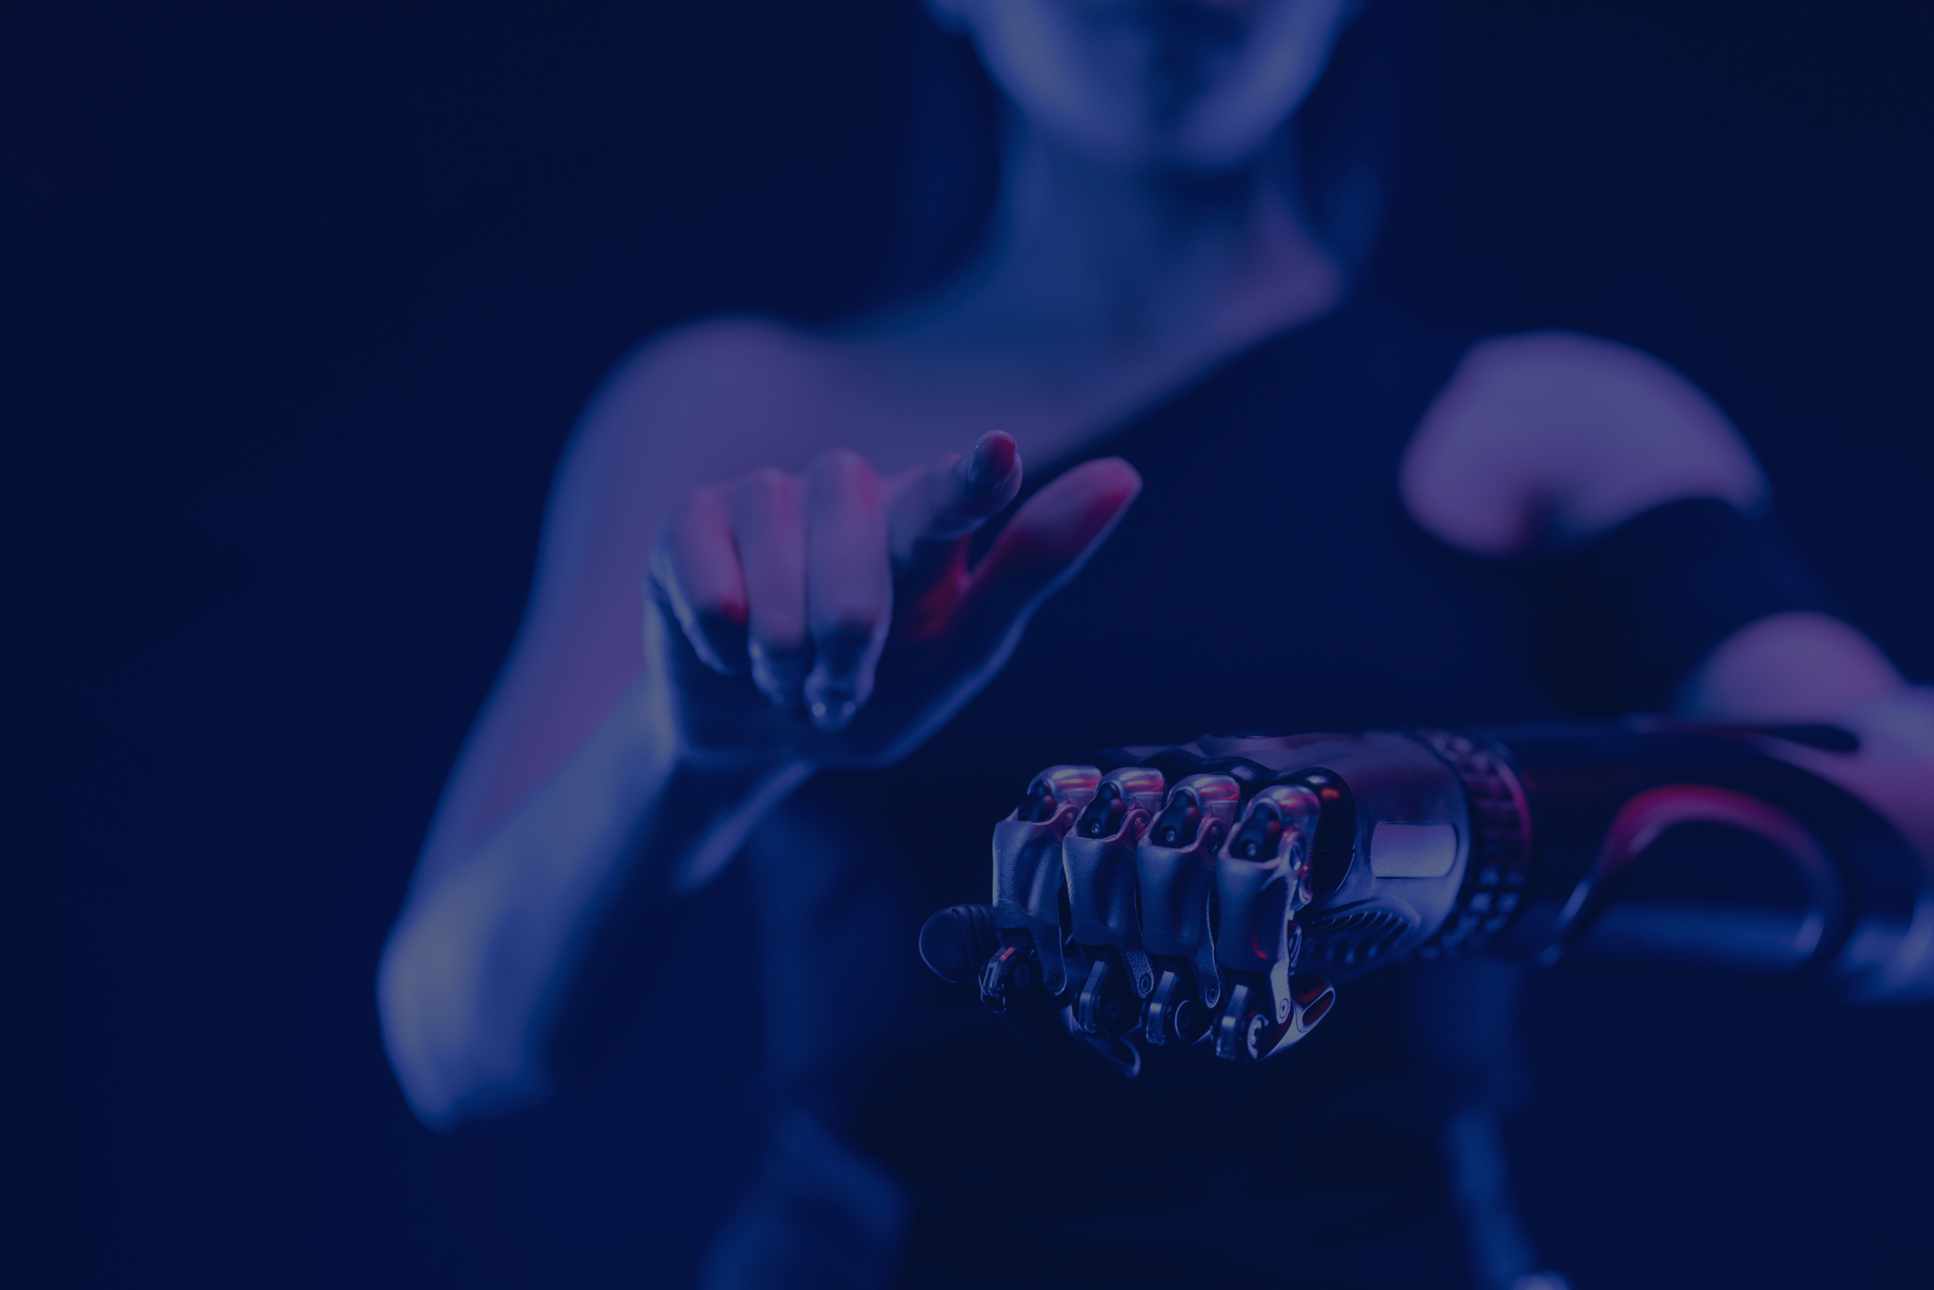
Object detection using YOLO and Pretrained Model
Department of CSE(AI), VIIT

Slide 2
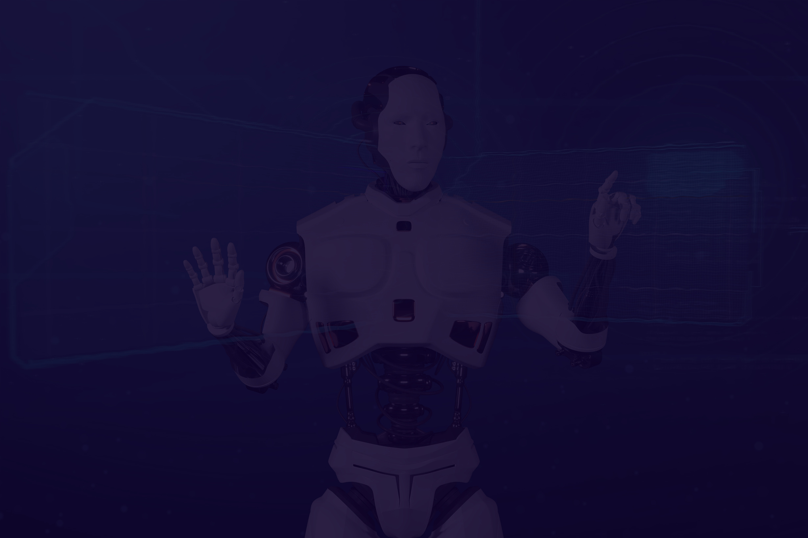
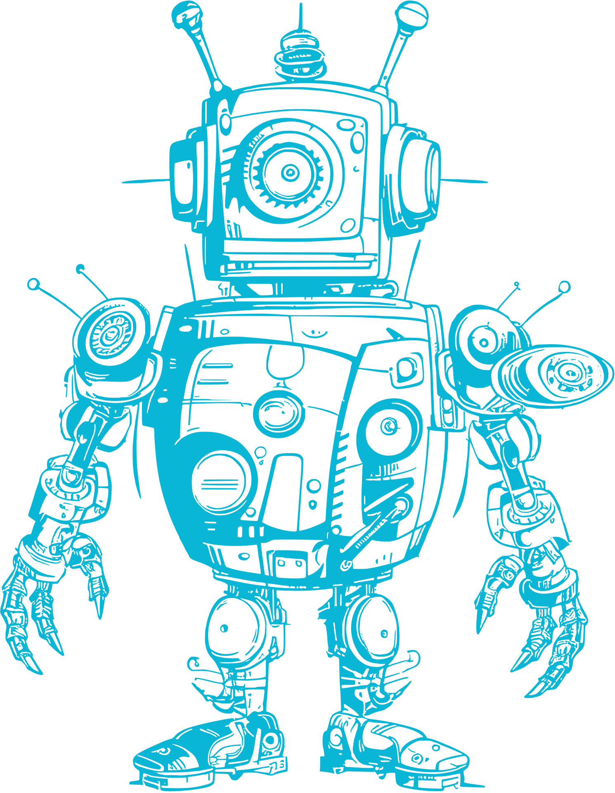
Team members
Name | Roll number | PRN number
Varad Sabane | 381057 | 22210518
Pranav Sathe | 381058 | 22210551
Guided By:
Dr. Anuradha Yenkikar
Department of CSE(AI), VIIT

Slide 3
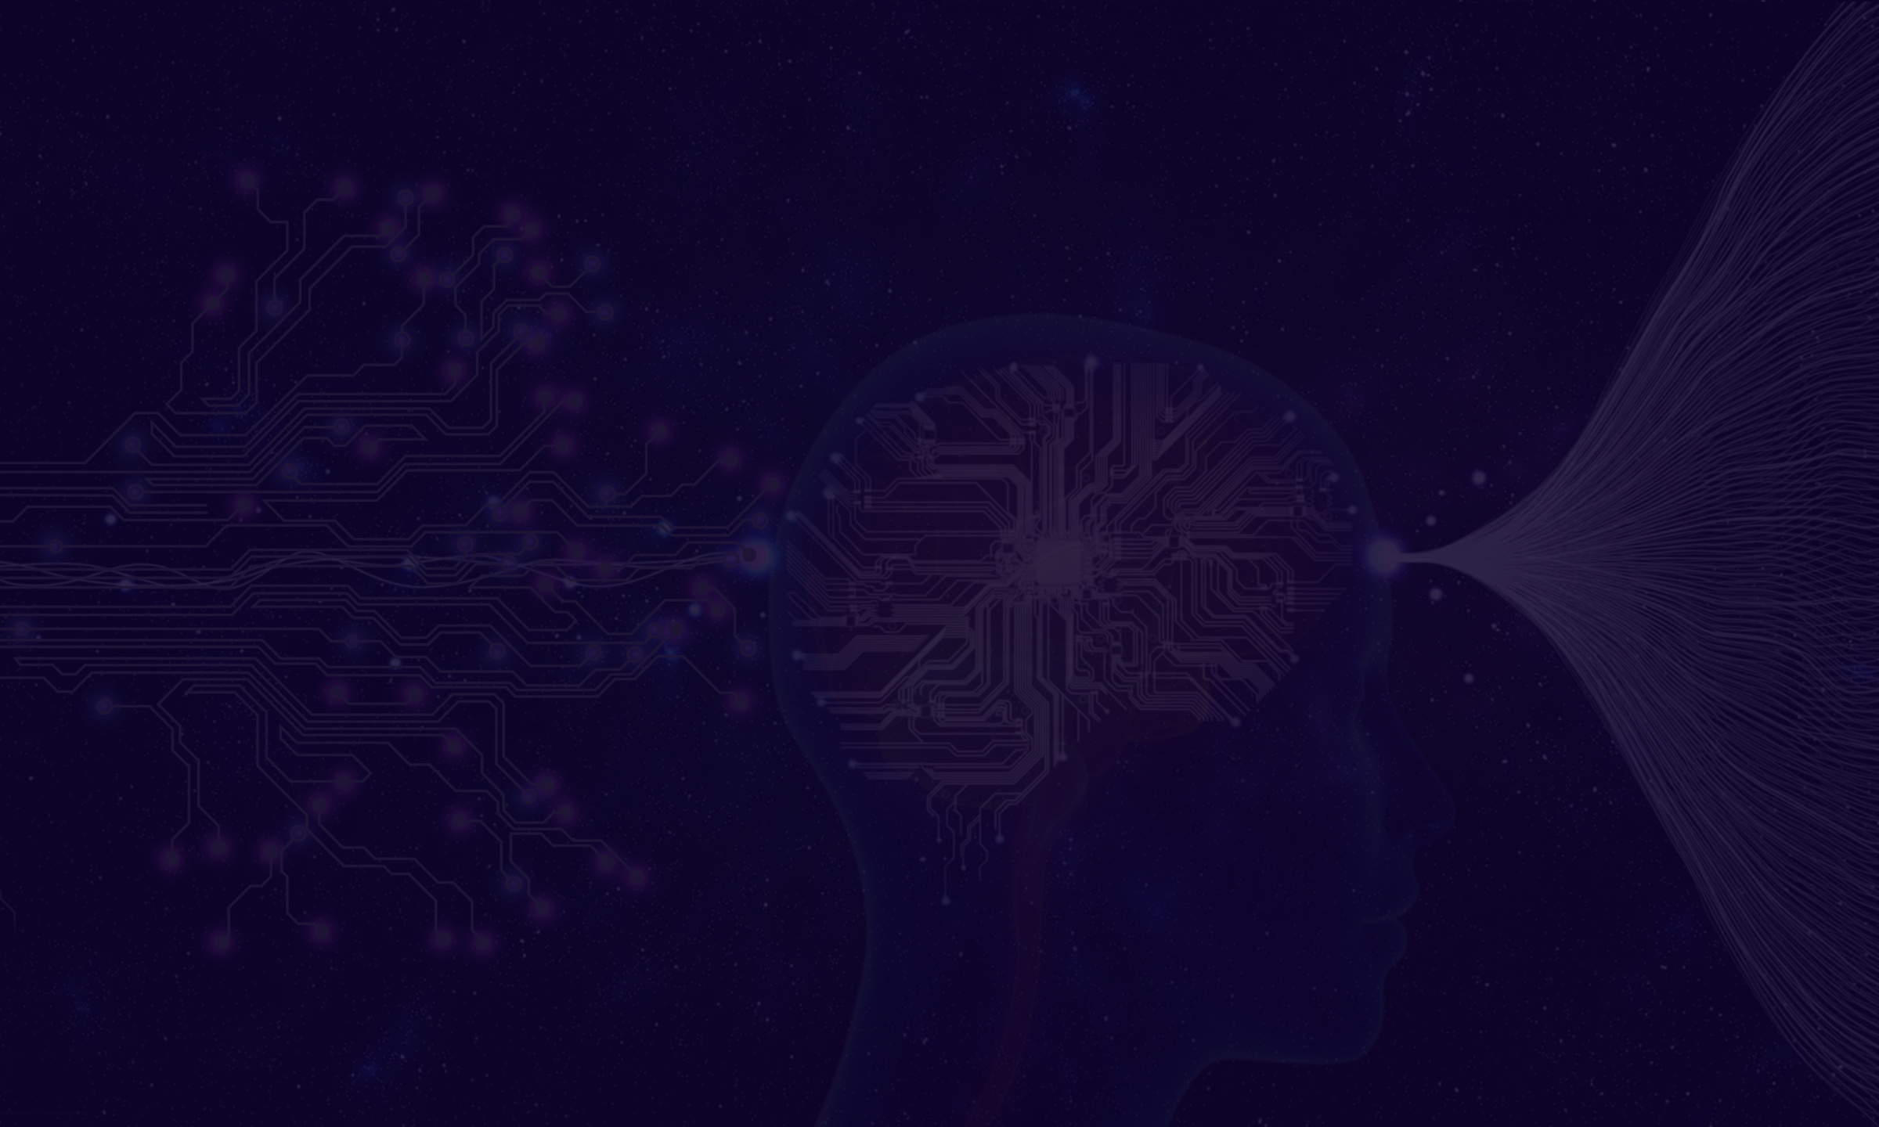

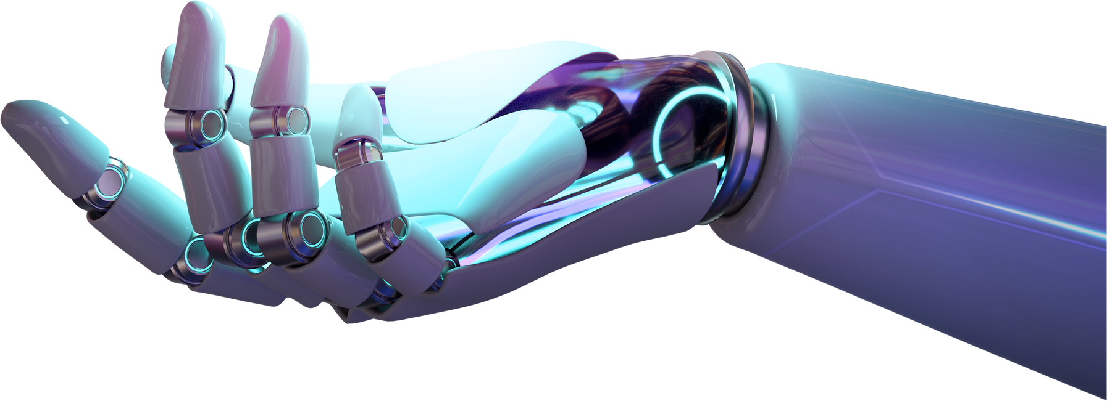
About YOLO
YOLO (You Only Look Once) is a real-time object detection algorithm developed by Joseph Redmon and Ali Farhadi in 2015.
It is a single-stage object detector that uses a convolutional neural network (CNN) to predict the bounding boxes and class probabilities of objects in input images.
YOLO has a simple architecture and requires minimal training data, making it easy to implement and adapt to new tasks.
Department of CSE(AI), VIIT

Slide 4
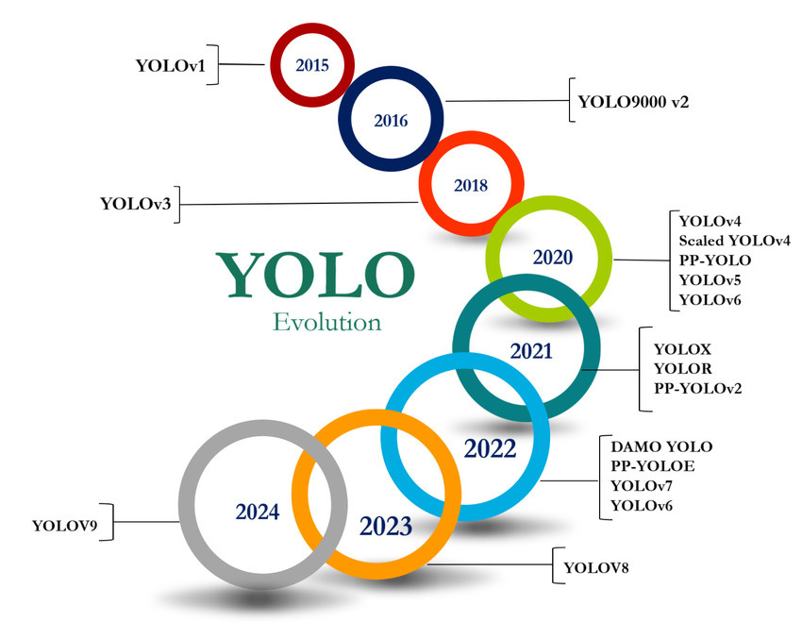
Why YOLO???
On the left side, we can see timeline of YOLO versions that means we can see that these algorithms are constantly evolving overcoming challenges of prior ones.
As of now, latest model is YOLOv9 which has not been fully released whereas YOLOv8 has been released as well as much upgradations in YOLOv8 have been done making it best algorithm as of now.
Department of CSE(AI), VIIT

Slide 5

Working of YOLOv8
GRID DIVISION
Bounding box prediction
Confidence Filtering
YOLOv8 divides the input image into a grid (let's say 7x7). Each grid cell will be responsible for detecting objects whose center falls inside that cell.
Each grid cell predicts bounding boxes (rectangular areas) that could contain objects.
YOLOv8 only keeps the bounding boxes with high confidence scores (boxes where it’s sure an object is present) and filters out weak or overlapping boxes.
Department of CSE(AI), VIIT

Slide 6
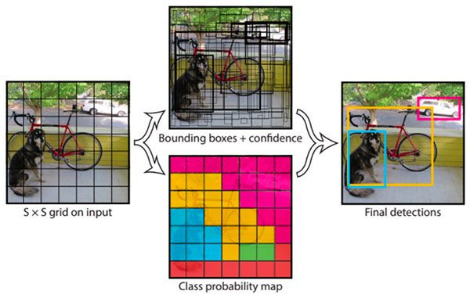
Department of CSE(AI), VIIT

Slide 7


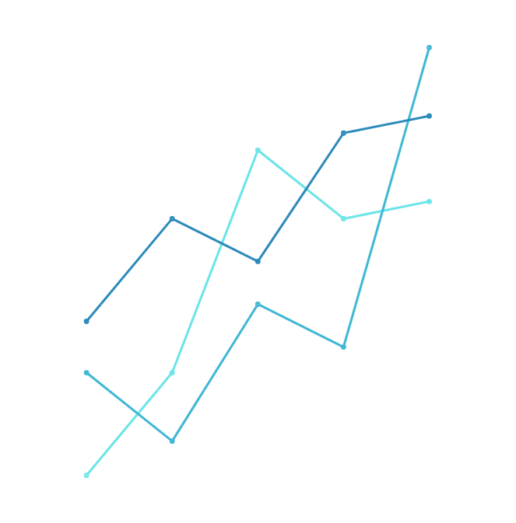
Evaluation
For each box, the model predicts:
A confidence score (how likely it is that the box contains an object).
Class probabilities (what type of object it is, like a dog, car, etc.).
Confidence score = P(Object) * IOU
Where, 1. P(Object) is probability that an object exists.
2. IoU is the ratio of the area of overlap between the predicted bounding box and the ground truth bounding box to the area of their union.
Department of CSE(AI), VIIT

Slide 8
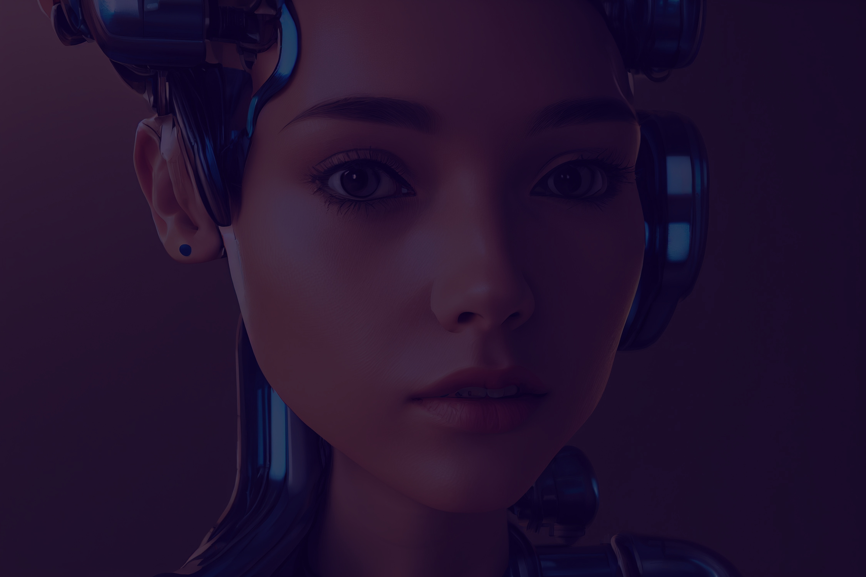
Applications
Autonomous Vehicles
Video Surveillance
Drones and UAVs
Medical Imaging
Retail and Inventory Management
Robotics
Smart Cities
Sport Analytics
Augmented Reality (AR)
Facial Recognition and Emotion Detection

Slide 9
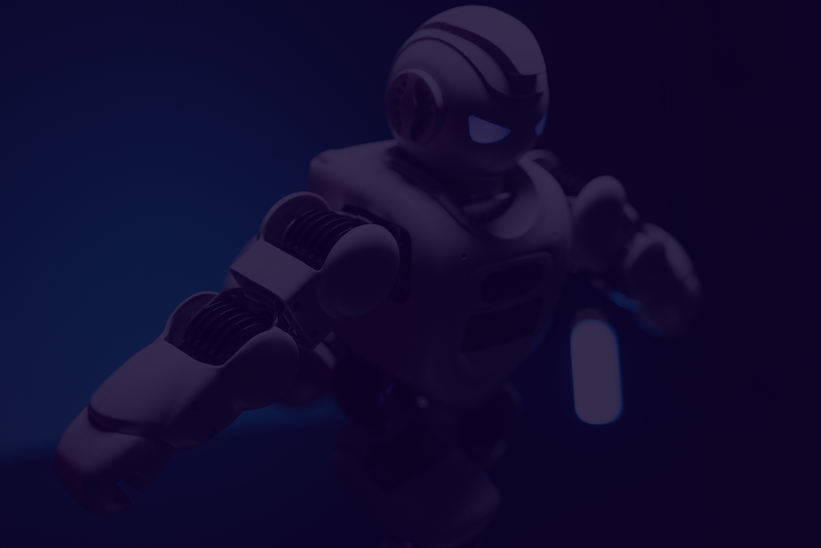


Thank You!

